Slide 1
2FA Facial Authentication For Websites

Slide 2
ACKOWNLEDGEMENT
An undertaking of work life - this is never an outcome of a single person; rather it bears the imprints of a number of people who directly and also indirectly helped me in completing the present study. I would be failing in my duties if I don't say a word of thanks to all those who made my training period educative and pleasurable one. I am thankful to SHARDA UNIVERSITY, GREATER NOIDA for giving me an opportunity.
First of all, I am extremely grateful to Ms. Yogita Sharma for her guidance, encouragement and tutelage during the course of the semester despite his extremely busy schedule. My very special thanks to her for giving me the
opportunity to do this project and for his support throughout as a mentor. I must thank my faculty guide Ms. Nitish Patil (Faculty, Sharda University) for his continuous support, mellow criticism and able directional guidance during the project. I would also like to thank all the respondents for giving their precious time and relevant information and experience, I required, without which the Project would have been incomplete. Finally, I would like to thank all lecturers, friends and my family for their kind support and to all who have directly or indirectly helped me in preparing this project report. And at last, I am thankful to all divine light and my parents, who kept my motivation and zest for knowledge always high through the tides of time.

Slide 3
ABSTRACT
This paper presents 2 Factor Authentication method using a a blinking-based liveness detection method for human face using Conditional Random Fields (CRFs) and Face Recognition Method Using OpenCV, our method only needs a web camera for capturing video clips. Blinking clue is a passive action and does not need the user to any hint, such as speaking, face moving. We model blinking activity by CRFs, which accommodates long-range contextual dependencies among the observation sequence. The experimental results demonstrate that the proposed method is promising, and outperforms the cascaded Adaboost method and HMM method, And Provide a promising 2FA for websites keeping the user data secure and safe.

Slide 4

Introduction
Biometrics are emerging technologies that enable the authentication of an individual based on physiological or behavioral characteristics, which including faces, fingerprints, irises, voices, etc. However, spoofing attack (or copy attack) is a serious threat for biometrics. Liveness detection in biometric systems can prevent spoofing attack, based on recognition of physiological activities as the sign of liveness.
Face recognition is one of the most useful biometrics and has many applications.

Slide 5
HARDWARE REQUIRMENTS
Working Internet Connection
Windows 7 Or upper
Webcam
4 GB RAM
2 GHz Processor

Slide 6

SOFTWARE REQUIRMENT
SOFTWARE
PYTHON 3.6
CMAKE
VISUAL STUDIOS 2019
Django
OpenCV
DLIB

Slide 7

TABLE OF CONTENTS
REGISTRATION PAGE
FACE REGISTRATION PAGE
FACE REGISTRATION PROCESS WINDOW
LOGIN PAGE
2 FACTOR FACE AUTH PAGE
BLINK TEST WINDOW
FACE COMPARISION WINDOW
HOME PAGE
INFORMATION PAGE

Slide 8
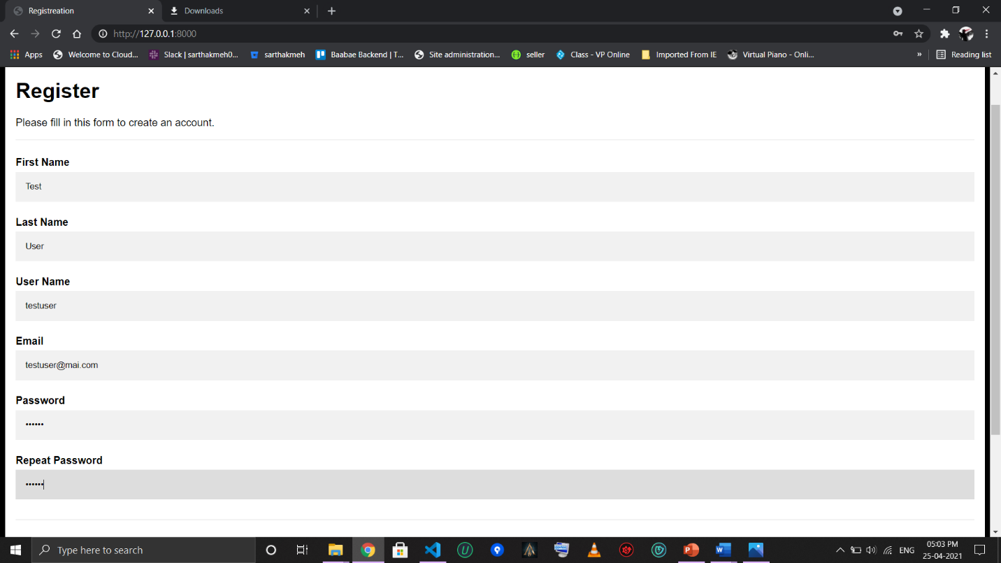
REGISTRATION PAGE
Registration Page is a form that takes user data to create an account on the website, Provide user with a user name to login with in future.

Slide 9
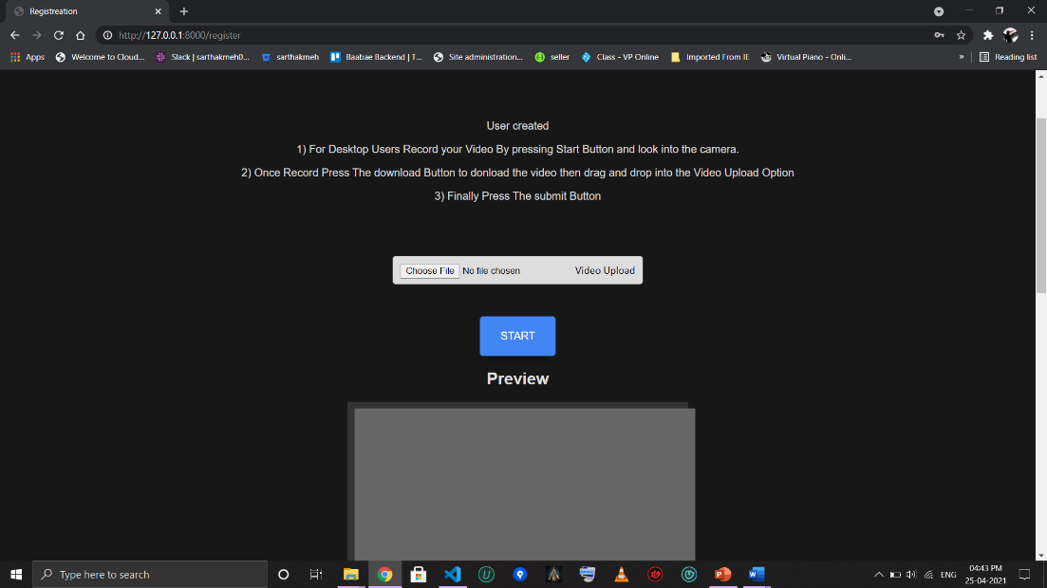
FACE REGISTRATION PAGE
Takes Video Input at the time of registration, this page registers the users face by converting his face taken from the video into 128 encoding that is save in the DB.

Slide 10
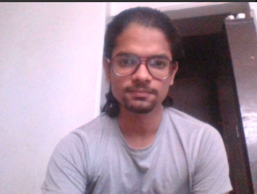
FACE REGISTRAION PROCESS WINDOW
This is the Process windows where the OpenCV is capturing frames from the video and converting them into encodings.

Slide 11
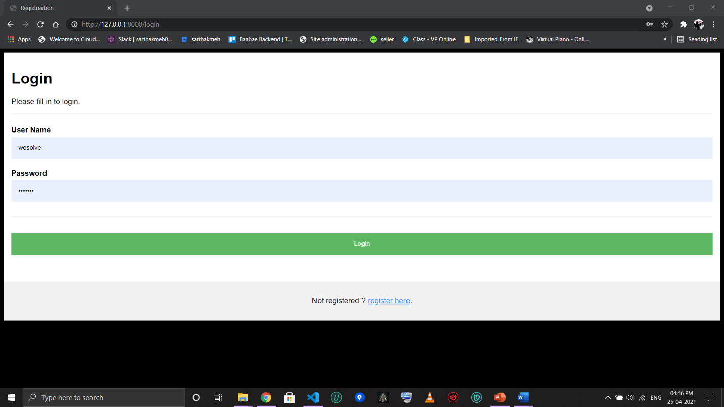
LOGIN PAGE
This is the classic Login Page.

Slide 12
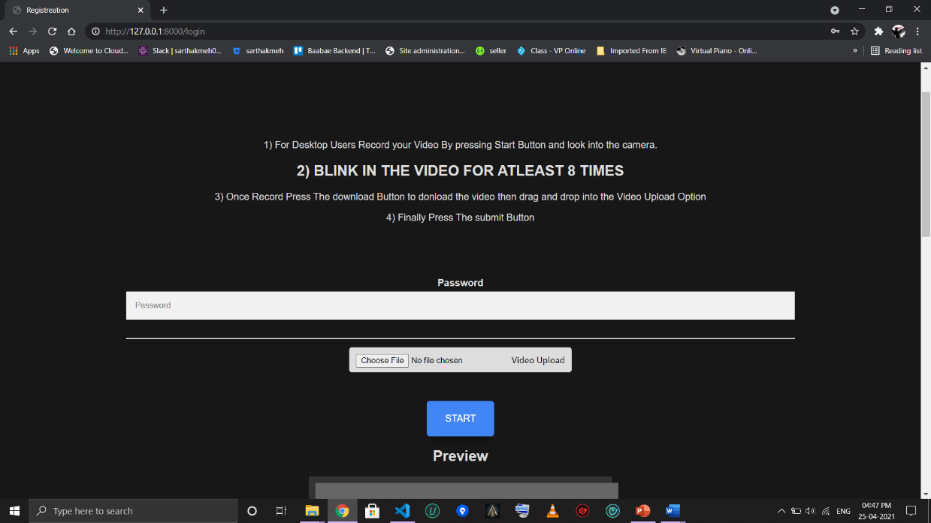
2 FACTOR FACE AUTH PAGE
After Successful login credential this is the 2FA page where user is required to record capture a video and for the blink test user is required to blink for at least 8 time.

Slide 13
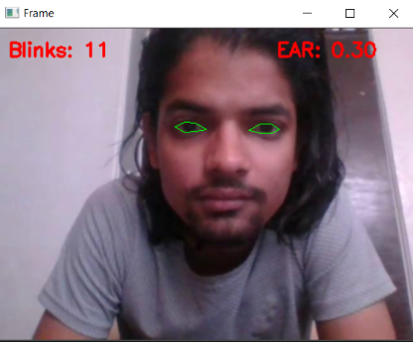
BLINK TEST WINDOW
This is the Process windows where the OpenCV and DLIB tracing the movement of eyes and ear and recording the no of blinks for liveliness AUTH test.

Slide 14
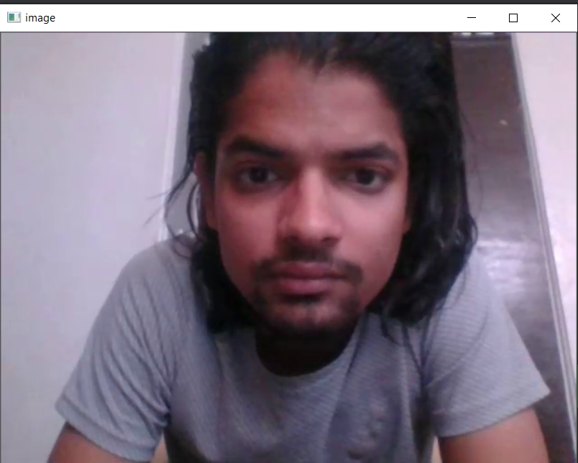
FACE COMPARISION WINDOW
This is the Process windows where the program is comparing the users registered encoding with the fresh auth encoding and Successful comparison with redirect user to home page.

Slide 15

HOME PAGE
HOME PAGE after successful authentication user will redirect here, where user can perform task as per the website provides, Here we provide user to securely write their story.

Slide 16
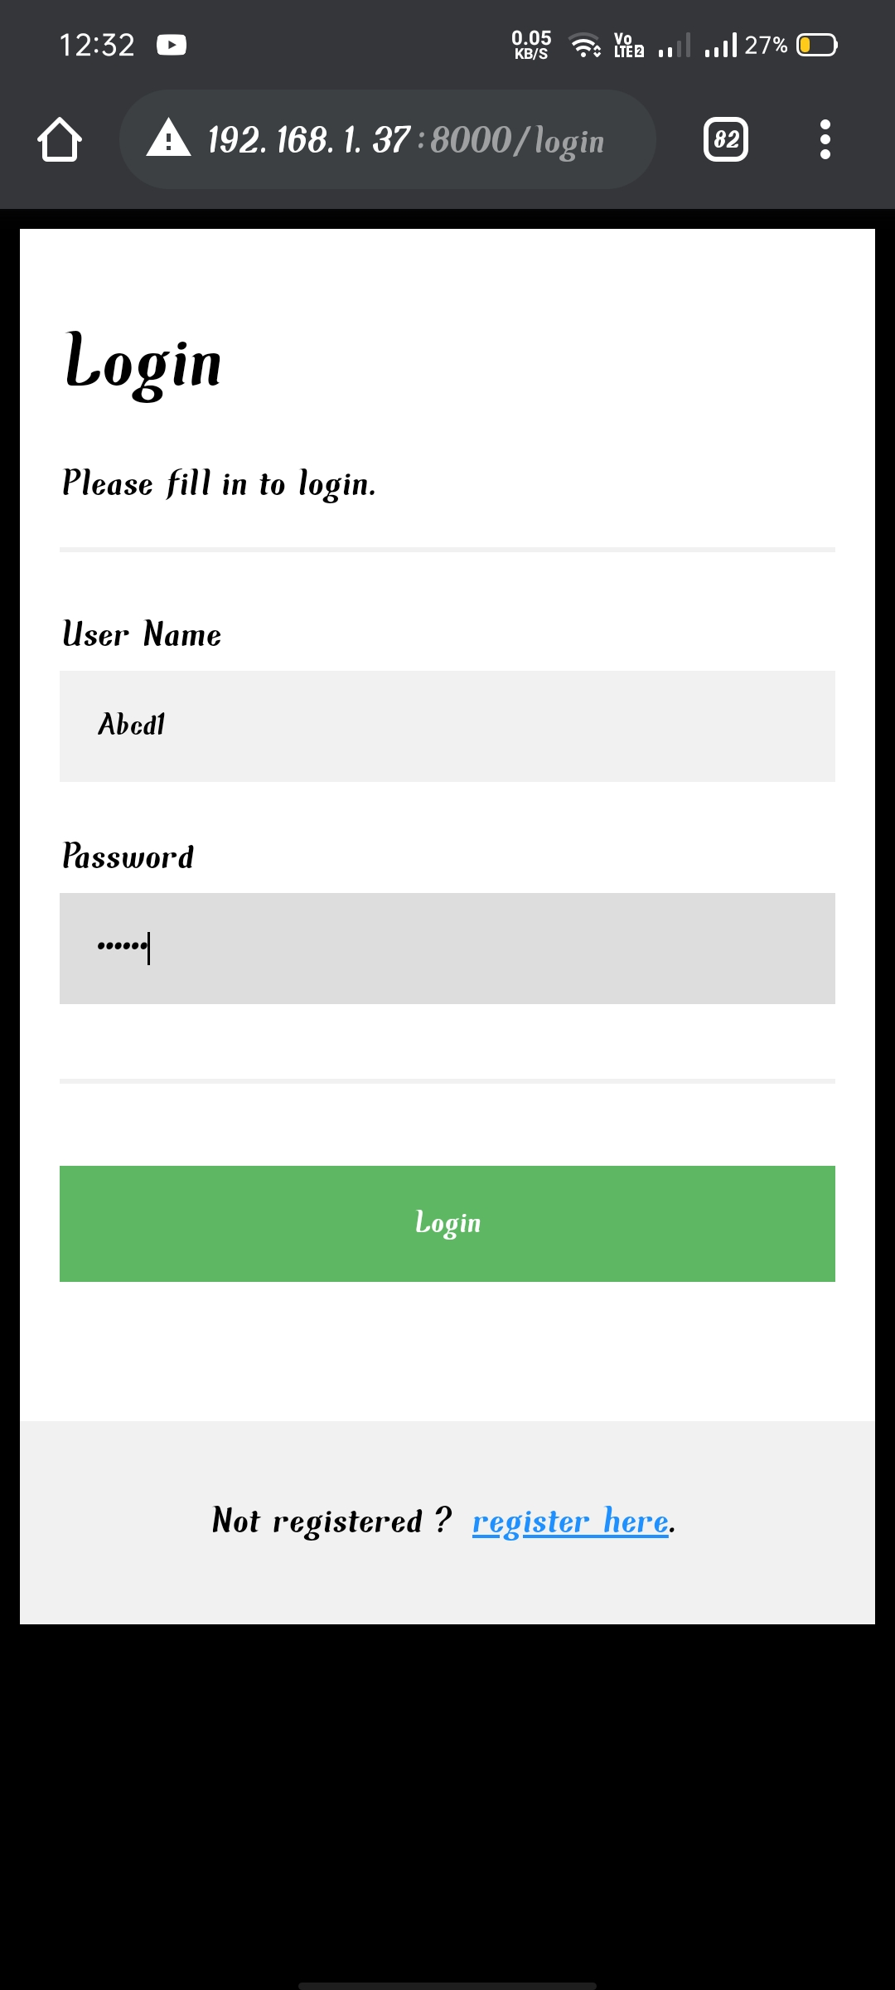
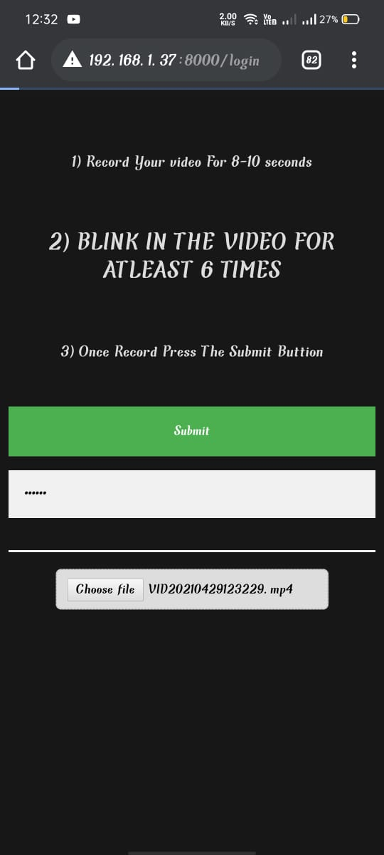

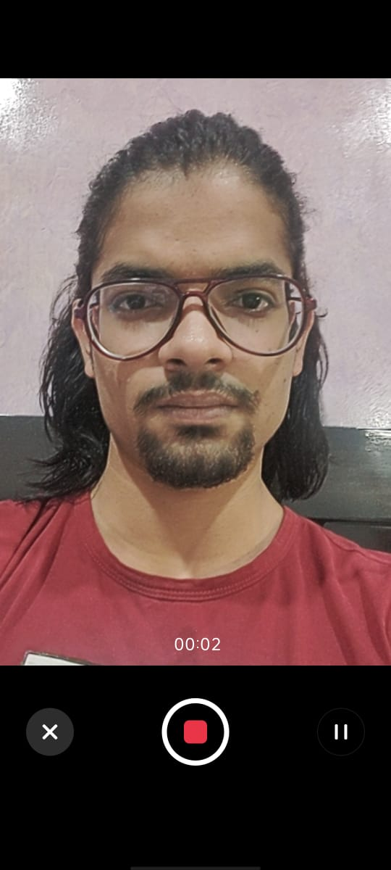

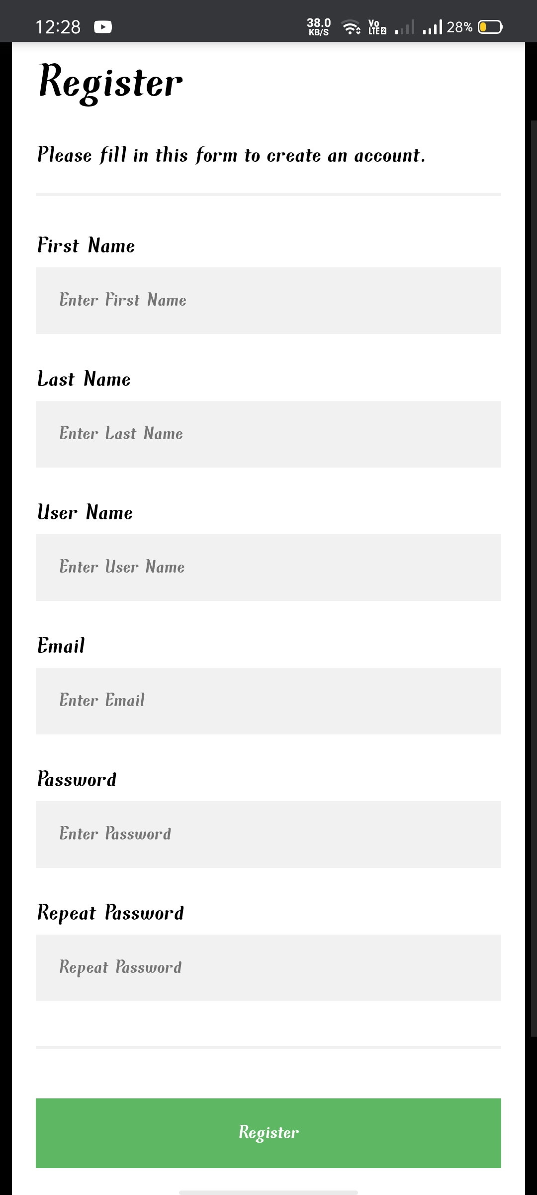
ANDROID/IOS COMPAITABLE
The Project is Android/IOS compatible and for mobile browsers it only let you record your live video and not drag and drop or select which makes it more secure.

Slide 17
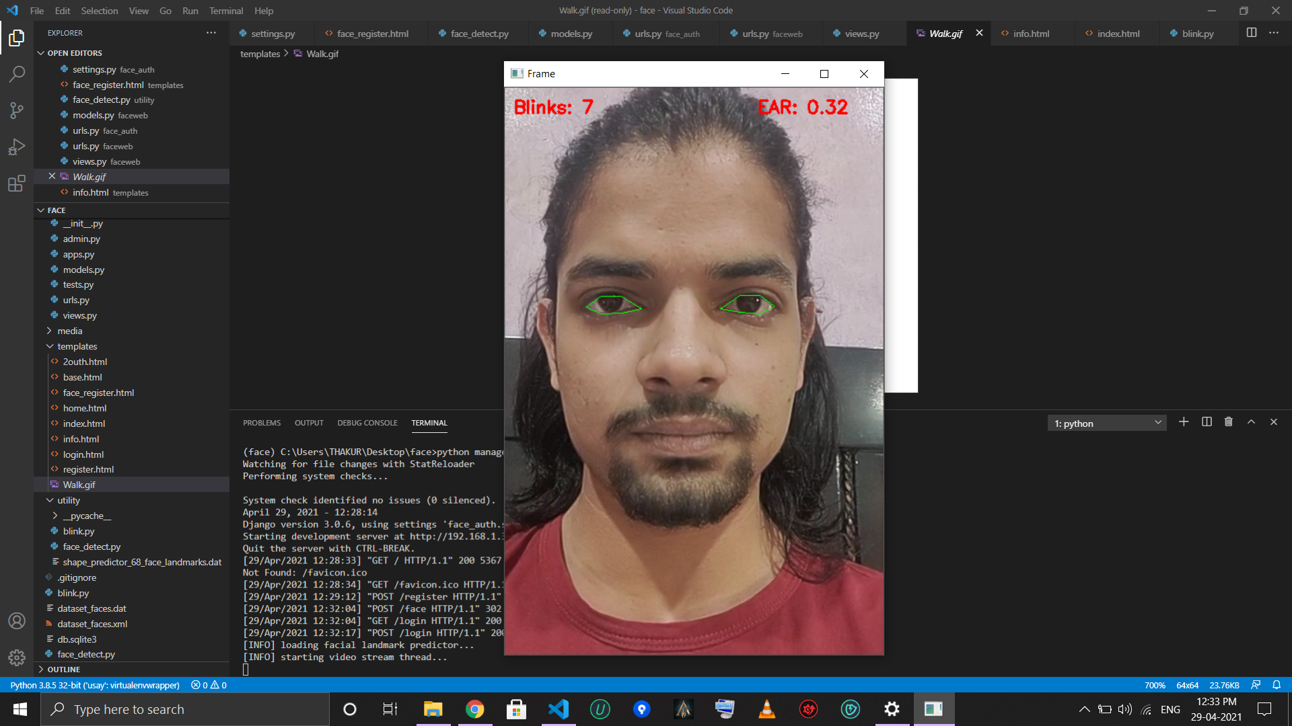
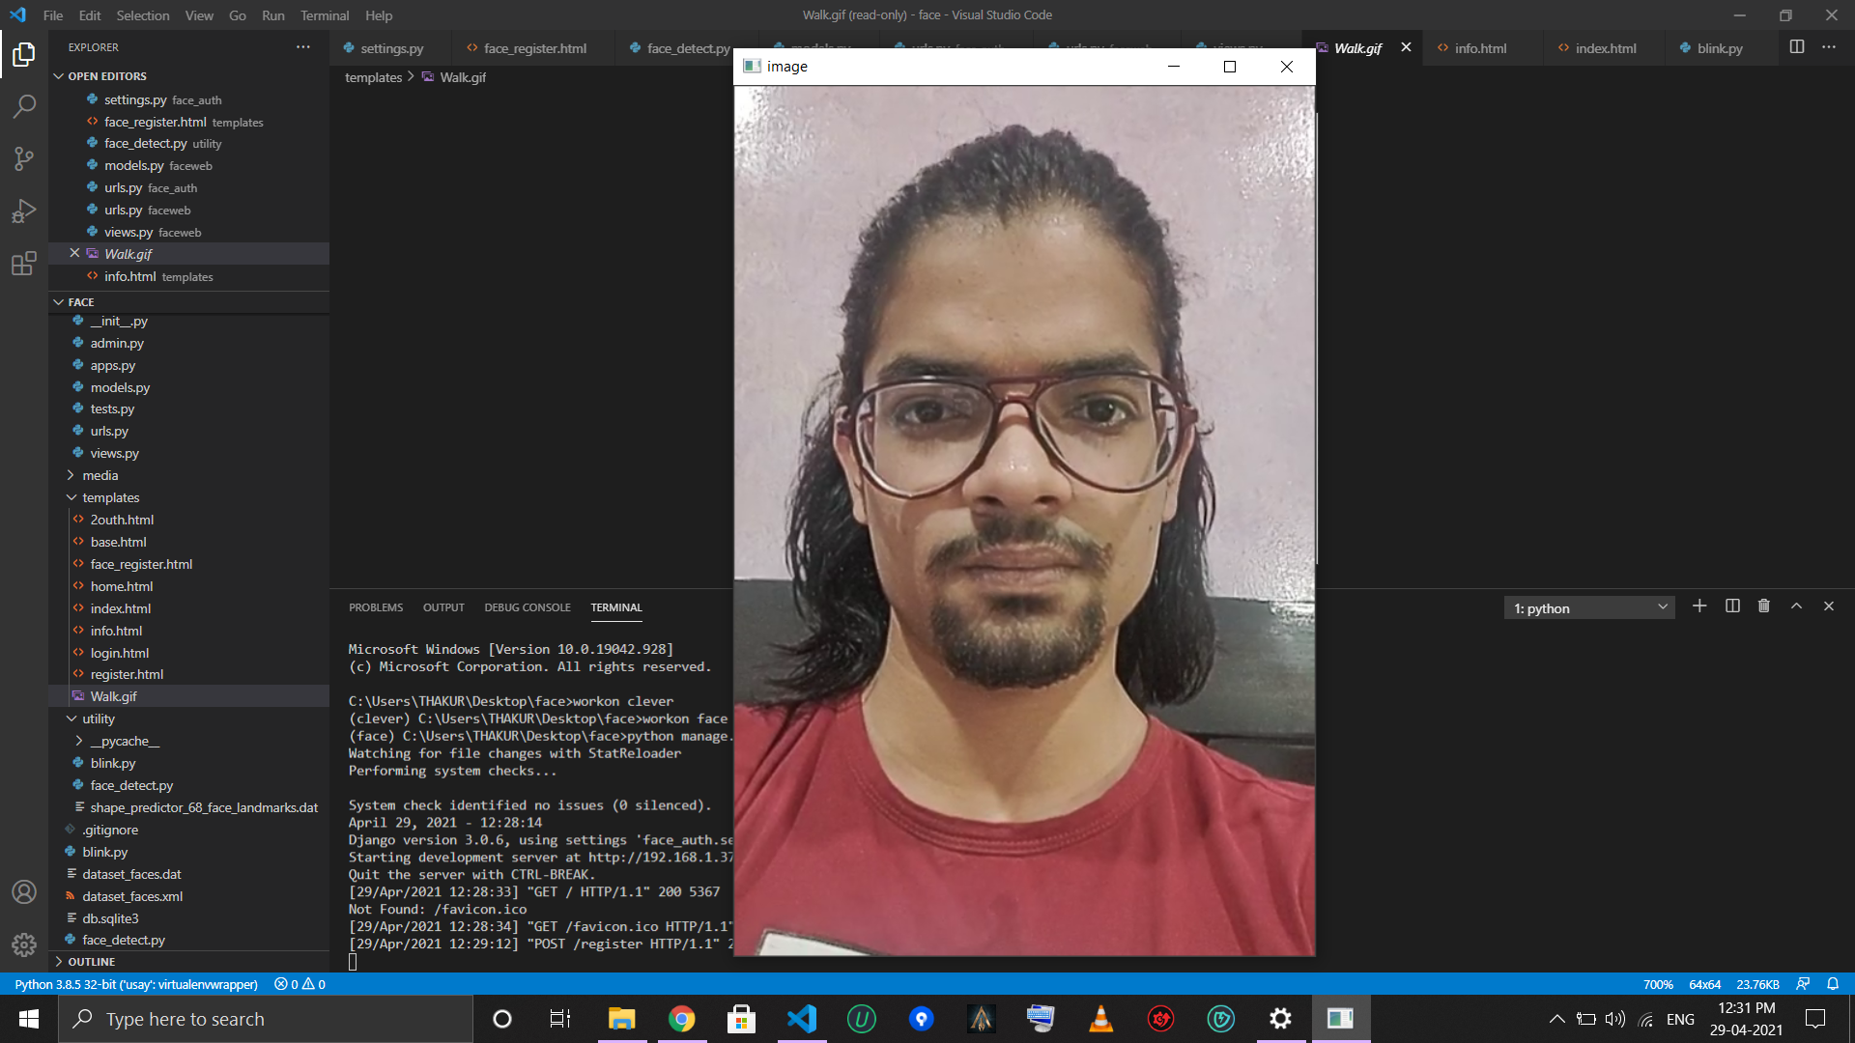
ANDROID/IOS COMPAITABLE
LIVE processing of videos captured from ANDROID device.

Slide 18
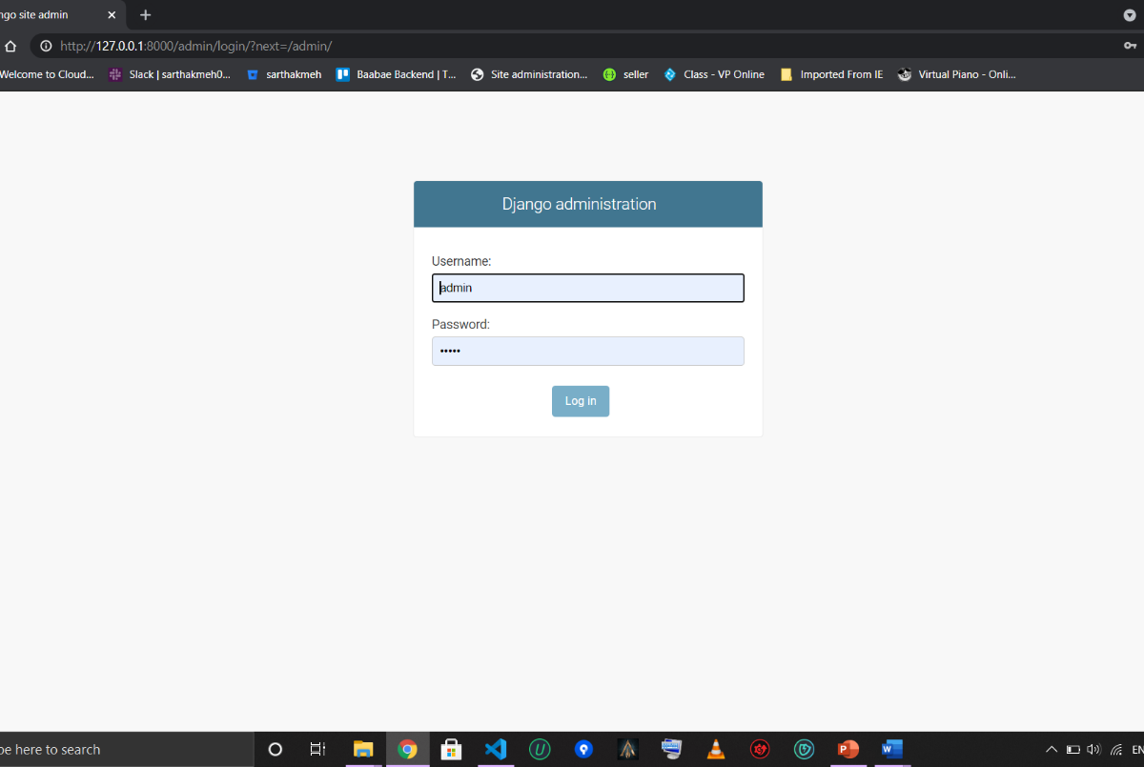
ADMIN PAGE (LOGIN)

Slide 19
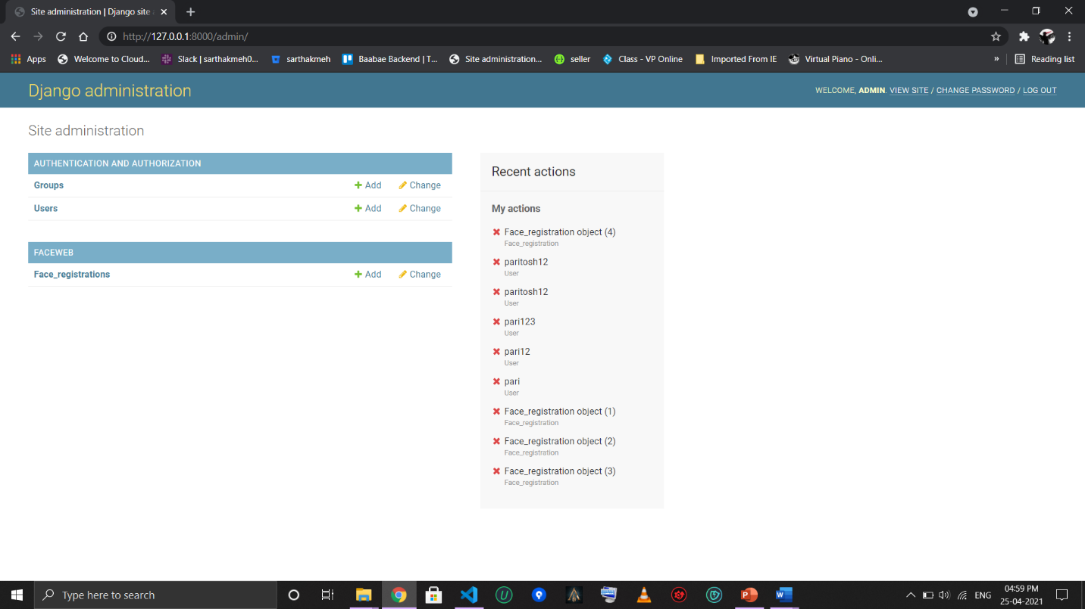
ADMIN PAGE
MANAGE THE DATA FOR BACKEND… Provided by Django framework…

Slide 20

INFO PAGE
INFORMATION PAGE ABOUTH THE APPLICATION AND CREATERS.

Slide 21
RESULTS AND DISCUSSION
This paper presented a 2 Factor Authentication for websites using face Recognition and Face liveliness Detection that use CRF-based framework for face liveness detection using blinking clue. CRFs, which can accommodate arbitrary overlapping features of the observation as well as long-range contextual dependencies on observation sequence, are suitable for modeling blinking activities for liveness detection.
The experimental results with cascaded AdaBoost, CRF and HMM show that CRF model significantly outperforms the other two models both in liveness detection and imposter detection.
The Live project Successfully register user and can withstand imposter and photo attack.
2FA is successfully implemented on the and provide an extra touch of security.

Slide 22
CONCLUSIONS AND RECOMMENDATIONS
Biometrics are emerging technologies that enable the authentication of an individual based on physiological or behavioral characteristics, which including faces, fingerprints, irises, voices, etc. However, spoofing attack (or copy attack) is a serious threat for biometrics. Liveness detection in biometric systems can prevent spoofing attack, based on recognition of physiological activities as the sign of liveness. Face recognition is one of the most useful biometrics and has many applications. However, the liveness detection in face recognition system has be little addressed. The vein map of the faces using ultra-violet cameras may be a secure method of identifying a live individual, but it needs additional expensive devices. It is a big challenge to detect live face from a web camera in face recognition system. A little work on live face detection has been done. Robert et al used the multi-modal approaches against spoofing, which need voice recorder and user collaboration. Choudhary et al used 3D depth information of a human head to detect live person. However, it is hard to estimate depth information when head is still. Li et al proposed Fourier spectra to classify live faces and the faked images, but it strongly depends on the data quality.

Slide 23
THANK YOU

